Slide 1
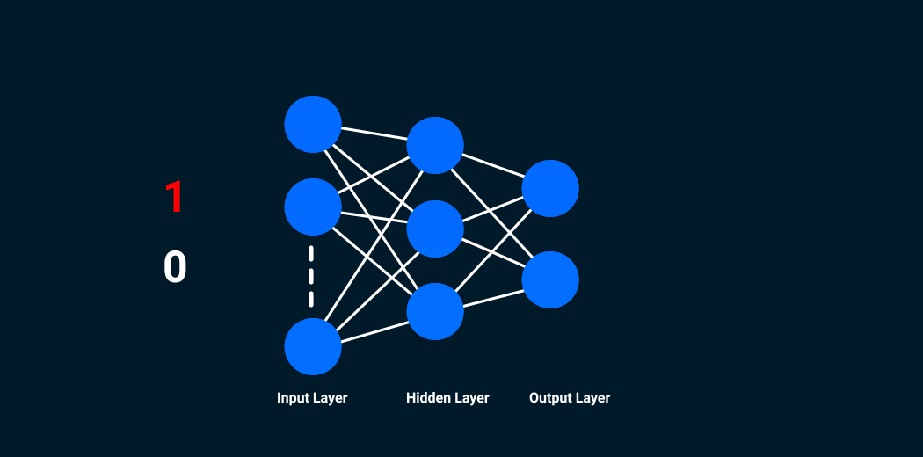
WHAT IS CNN
Prof.Dr. Sami Ekici
Firat University

Slide 2
What is different in CNN?
Convolutional Neural Networks are very similar to ordinary Neural Networks: they are made up of neurons that have learnable weights and biases.
Each neuron receives some inputs, performs a dot product and optionally follows it with a non-linearity.
The whole network still expresses a single differentiable score function: from the raw image pixels on one end to class scores at the other.
And they still have a loss function (e.g. SVM/Softmax) on the last (fully-connected) layer and all the tips/tricks we developed for learning regular Neural Networks still apply.

Slide 3
So what changes?
ConvNet architectures make the explicit assumption that the inputs are images, which allows us to encode certain properties into the architecture.
These then make the forward function more efficient to implement and vastly reduce the amount of parameters in the network.

Slide 4
Architecture Overview
As we know, Neural Networks receive an input (a single vector), and transform it through a series of hidden layers.
Each hidden layer is made up of a set of neurons, where each neuron is fully connected to all neurons in the previous layer, and where neurons in a single layer function completely independently and do not share any connections.
The last fully-connected layer is called the “output layer” and in classification settings it represents the class scores.

Slide 5
Regular Neural Nets for images
Regular Neural Nets don’t scale well to full images. In CIFAR-10, images are only of size 32x32x3 (32 wide, 32 high, 3 color channels), so a single fully-connected neuron in a first hidden layer of a regular Neural Network would have 32*32*3 = 3072 weights.
This amount still seems manageable, but clearly this fully-connected structure does not scale to larger images.
For example, an image of more respectable size, e.g. 200x200x3, would lead to neurons that have 200*200*3 = 120,000 weights.
Moreover, we would almost certainly want to have several such neurons, so the parameters would add up quickly!
Clearly, this full connectivity is wasteful and the huge number of parameters would quickly lead to overfitting.

Slide 6
Understanding of Convolutional Neural Network (CNN)
Convolutional neural networks (CNNs or ConvNets) are one of the main neural networks which are especially used in image recognition applications.
Face recognition, object detection, desease identification, computer vision are some of the areas where CNNs are widely used.
CNN image classifications takes an input image, process it and classify it under certain categories (Eg., Dog, Cat, Tiger, Lion).
Computers sees an input image as array of pixels and it depends on the image resolution.
Based on the image resolution, it will see h x w x d( h = Height, w = Width, d = Dimension ).

Slide 7
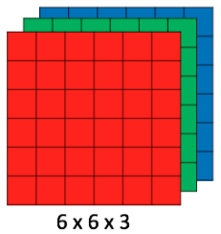
RGB (red-green-blue) images
Eg., An image of 6 x 6 x 3 array of matrix of RGB (3 refers to RGB values) and an image of 4 x 4 x 1 array of matrix of grayscale image.
Figure 1 : Array of RGB Matrix

Slide 8
3D volumes of neurons
Convolutional Neural Networks take advantage of the fact that the input consists of images and they constrain the architecture in a more sensible way.
In particular, unlike a regular Neural Network, the layers of a ConvNet have neurons arranged in 3 dimensions: width, height, depth.
Note that the word depth here refers to the third dimension of an activation volume, not to the depth of a full Neural Network, which can refer to the total number of layers in a network.
For example, the input images in CIFAR-10 are an input volume of activations, and the volume has dimensions 32x32x3 (width, height, depth respectively).

Slide 9
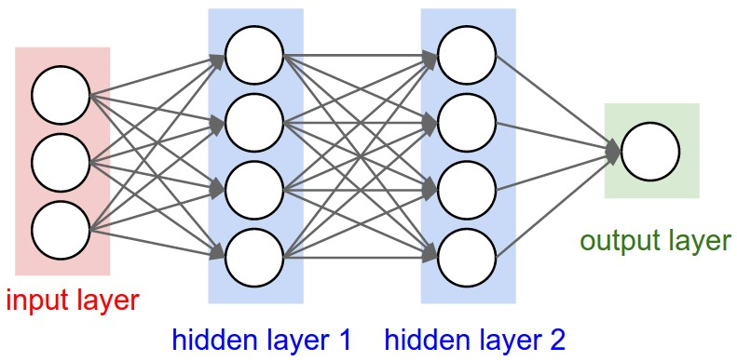
As we will soon see, the neurons in a layer will only be connected to a small region of the layer before it, instead of all of the neurons in a fully-connected manner.
Moreover, the final output layer would for CIFAR-10 have dimensions 1x1x10, because by the end of the ConvNet architecture we will reduce the full image into a single vector of class scores, arranged along the depth dimension.
A regular 3-layer Neural Network

Slide 10
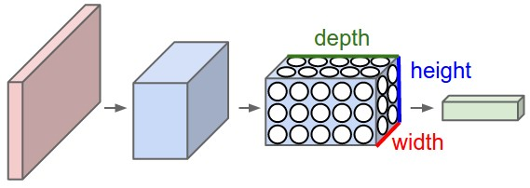
A ConvNet arranges its neurons in three dimensions (width, height, depth), as visualized in one of the layers.
Every layer of a ConvNet transforms the 3D input volume to a 3D output volume of neuron activations.
In this example, the red input layer holds the image, so its width and height would be the dimensions of the image, and the depth would be 3 (Red, Green, Blue channels).

Slide 11
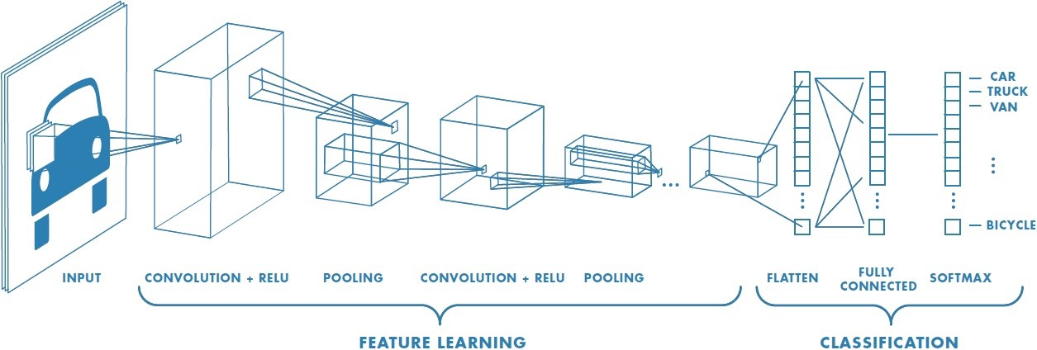
Deep learning CNN models to train and test, each input image will pass it through a series of convolution layers with filters (Kernels), Pooling, fully connected layers (FC) and apply Softmax function to classify an object with probabilistic values between 0 and 1.
Figure 2 : Neural network with many convolutional layers

Slide 12
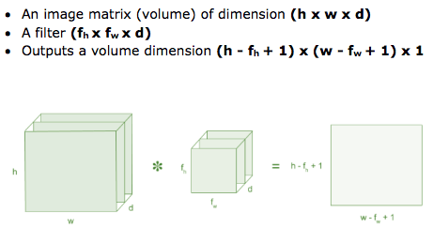
Convolution Layer
Convolution is the first layer to extract features from an input image.
Convolution preserves the relationship between pixels by learning image features using small squares of input data.
It is a mathematical operation that takes two inputs such as image matrix and a filter or kernel.

Slide 13
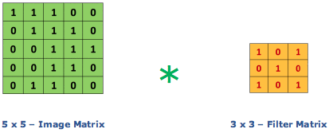
Consider a 5 x 5 whose image pixel values are 0, 1 and filter matrix 3 x 3 as shown in below
Figure: Image matrix multiplies kernel or filter matrix

Slide 14
Convolution
The Main objective of convolution in relation to Convnet is to extract features from the input image.
This layer does most of the computation in a ConvNet.
Lets try to understand how this convolution works
In mathematics, convolution is a mathematical operation on two functions that produces a third function—that is, the modified (convoluted) version of one of the original functions.
The resulting function gives in integral of the pointwise multiplication of the two functions as a function of the amount that one of the original functions is translated .

Slide 15
Convolution
Convolution involves the multiplication of 2 functions, f and g, to produce a new modified function ( f * g ).
For example Convolution between an image say f with a filter function , g will produce a new version of the image
Lets start manually convolving 4 X 4 input with 3 X 3 filter.
The first step in the convolution process is to take the element wise product of the filter and the local receptive field (first nine boxes) of the input

Slide 16
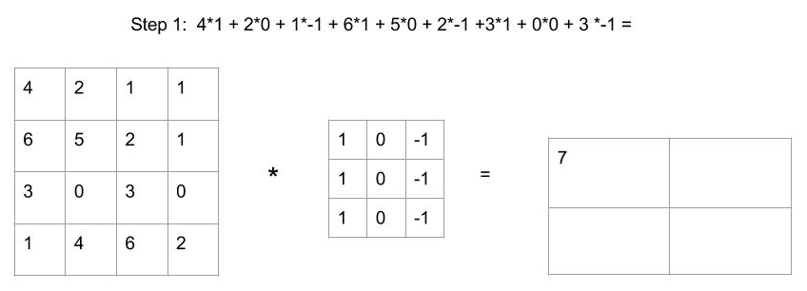
Convolution

Slide 17
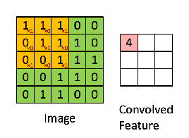
The convolution of 5 x 5 image matrix multiplies with 3 x 3 filter matrix which is called “Feature Map” as output shown in below
Figure: 3 x 3 Output matrix

Slide 18
Deeper understanding of CNN
One major problem with computer vision problems is that the input data can get really big.
Suppose an image is of the size 68 X 68 X 3. The input feature dimension then becomes 12,288.
This will be even bigger if we have larger images (say, of size 720 X 720 X 3).
Now, if we pass such a big input to a neural network, the number of parameters will swell up to a HUGE number (depending on the number of hidden layers and hidden units).
This will result in more computational and memory requirements – not something most of us can deal with.

Slide 19

Edge Detection Example
The early layers of a neural network detect edges from an image(Why?).
Deeper layers might be able to detect the cause of the objects and even more deeper layers might detect the cause of complete objects (like a person’s face).
In this section, we will focus on how the edges can be detected from an image. Suppose we are given the below image:

Slide 20
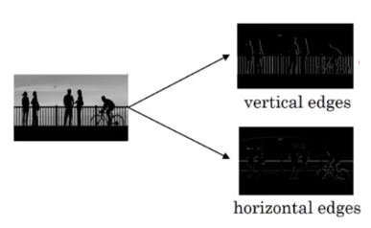
As you can see, there are many vertical and horizontal edges in the image. The first thing to do is to detect these edges:

Slide 21
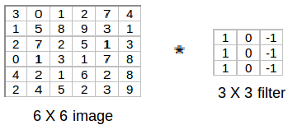
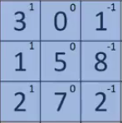
But how do we detect these edges? To illustrate this, let’s take a 6 X 6 grayscale image (i.e. only one channel):
Next, we convolve this 6 X 6 matrix with a 3 X 3 filter:
After the convolution, we will get a 4 X 4 image. The first element of the 4 X 4 matrix will be calculated as:

Slide 22
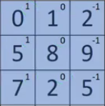
So, we take the first 3 X 3 matrix from the 6 X 6 image and multiply it with the filter.
Now, the first element of the 4 X 4 output will be the sum of the element-wise product of these values, i.e. 3*1 + 0 + 1*-1 + 1*1 + 5*0 + 8*-1 + 2*1 + 7*0 + 2*-1 = -5.
To calculate the second element of the 4 X 4 output, we will shift our filter one step towards the right and again get the sum of the element-wise product:
0+0+2*-1+5*1+0+9*-1+7*1+0+5*-1=-4

Slide 23

Similarly, we will convolve over the entire image and get a 4 X 4 output:
So, convolving a 6 X 6 input with a 3 X 3 filter gave us an output of 4 X 4.

Slide 24
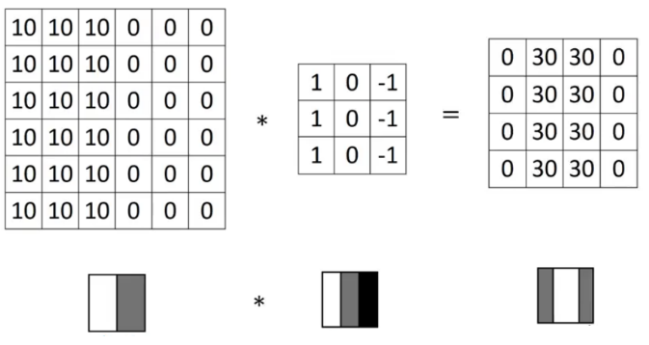
Consider one more example:
Note: Higher pixel values represent the brighter portion of the image and the lower pixel values represent the darker portions. This is how we can detect a vertical edge in an image.

Slide 25
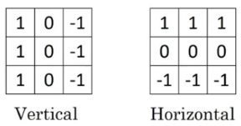
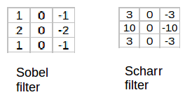
More Edge Detection
The type of filter that we choose helps to detect the vertical or horizontal edges. We can use the following filters to detect different edges:
Some of the commonly used filters are:
The Sobel filter puts a little bit more weight on the central pixels. Instead of using these filters, we can create our own as well and treat them as a parameter which the model will learn using backpropagation.

Slide 26
Padding
There are primarily two disadvantages here:
Every time we apply a convolutional operation, the size of the image shrinks
Pixels present in the corner of the image are used only a few number of times during convolution as compared to the central pixels.
Hence, we do not focus too much on the corners since that can lead to information loss

Slide 27
We have seen that convolving an input of 6 X 6 dimension with a 3 X 3 filter results in 4 X 4 output.
We can generalize it and say that if the input is n X n and the filter size is f X f, then the output size will be (n-f+1) X (n-f+1):
Input: n X n
Filter size: f X f
Output: (n-f+1) X (n-f+1)

Slide 28
To overcome these issues, we can pad the image with an additional border, i.e., we add one pixel all around the edges.
This means that the input will be an 8 X 8 matrix (instead of a 6 X 6 matrix).
Applying convolution of 3 X 3 on it will result in a 6 X 6 matrix which is the original shape of the image. This is where padding comes to the fore:
Input: n X n
Padding: p
Filter size: f X f
Output: (n+2p-f+1) X (n+2p-f+1)

Slide 29
There are two common choices for padding:
Valid: It means no padding. If we are using valid padding, the output will be (n-f+1) X (n-f+1)
Same: Here, we apply padding so that the output size is the same as the input size, i.e.,
n+2p-f+1 = n
So, p = (f-1)/2
We now know how to use padded convolution.
This way we don’t lose a lot of information and the image does not shrink either.
Next, we will look at how to implement strided convolutions.

Slide 30
Strided Convolutıions
Suppose we choose a stride of 2. So, while convoluting through the image, we will take two steps – both in the horizontal and vertical directions separately. The dimensions for stride s will be:
Input: n X n
Padding: p
Stride: s
Filter size: f X f
Output: [(n+2p-f)/s+1] X [(n+2p-f)/s+1]
Stride helps to reduce the size of the image, a particularly useful feature.

Slide 31
Convolutions Over Volume
Suppose, instead of a 2-D image, we have a 3-D input image of shape 6 X 6 X 3. How will we apply convolution on this image? We will use a 3 X 3 X 3 filter instead of a 3 X 3 filter. Let’s look at an example:
Input: 6 X 6 X 3
Filter: 3 X 3 X 3
The dimensions above represent the height, width and channels in the input and filter.
Keep in mind that the number of channels in the input and filter should be same.
This will result in an output of 4 X 4. Let’s understand it visually:

Slide 32
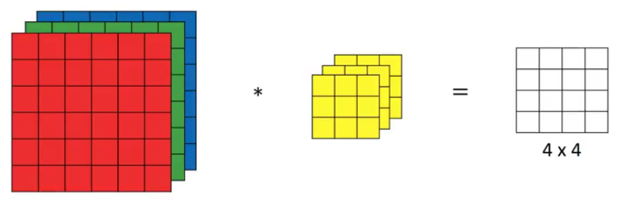
Since there are three channels in the input, the filter will consequently also have three channels.
After convolution, the output shape is a 4 X 4 matrix. So, the first element of the output is the sum of the element-wise product of the first 27 values from the input (9 values from each channel) and the 27 values from the filter.
After that we convolve over the entire image.

Slide 33
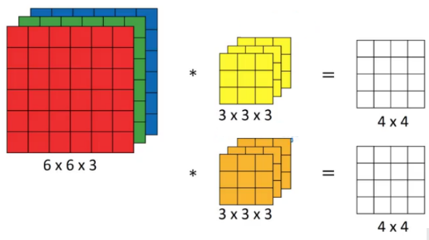
Instead of using just a single filter, we can use multiple filters as well.
How do we do that? Let’s say the first filter will detect vertical edges and the second filter will detect horizontal edges from the image.
If we use multiple filters, the output dimension will change.
So, instead of having a 4 X 4 output as in the above example, we would have a 4 X 4 X 2 output (if we have used 2 filters):

Slide 34
Generalized dimensions
Input: n X n X n_{c}
Filter: f X f X n_{c}
Padding: p
Stride: s
Output: [(n+2p-f)/s+1] X [(n+2p-f)/s+1] X n_{c}’
Here, n_{c} is the number of channels in the input and filter, while n_{c}’ is the number of filters.

Slide 35
One Layer of a Convolutional Network
Once we get an output after convolving over the entire image using a filter, we add a bias term to those outputs and finally apply an activation function to generate activations.
This is one layer of a convolutional network.
Recall that the equation for one forward pass is given by:
z^{[1]} = w^{[1]}*a^{[0]} + b^{[1]}
a^{[1]} = g(z^{[1]})

Slide 36
In our case, input (6 X 6 X 3) is a^{[0]}and filters (3 X 3 X 3) are the weights w^{[1]}.
These activations from layer 1 act as the input for layer 2, and so on.
Clearly, the number of parameters in case of convolutional neural networks is independent of the size of the image.
It essentially depends on the filter size.
Suppose we have 10 filters, each of shape 3 X 3 X 3. What will be the number of parameters in that layer? Let’s try to solve this:
Number of parameters for each filter = 3*3*3 = 27
There will be a bias term for each filter, so total parameters per filter = 28
As there are 10 filters, the total parameters for that layer = 28*10 = 280

Slide 37
No matter how big the image is, the parameters only depend on the filter size.
Awesome, isn’t it?
Let’s have a look at the summary of notations for a convolution layer:
f^{[l]} = filter size
p^{[l]} = padding
s^{[l]} = stride
n_{[c]}^{[l]} = number of filters
Let’s combine all the concepts we have learned so far and look at a convolutional network example.

Slide 38
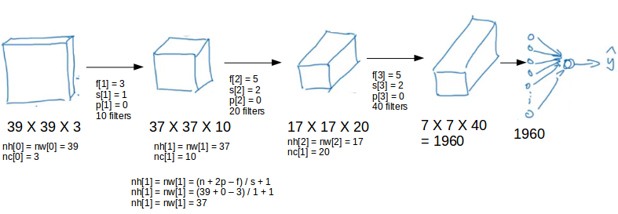
Simple Convolutional Network Example
This is how a typical convolutional network looks like:

Slide 39
We take an input image (size = 39 X 39 X 3 in our case), convolve it with 10 filters of size 3 X 3, and take the stride as 1 and no padding.
This will give us an output of 37 X 37 X 10.
We convolve this output further and get an output of 7 X 7 X 40 as shown above.
Finally, we take all these numbers (7 X 7 X 40 = 1960), unroll them into a large vector, and pass them to a classifier that will make predictions.
This is a microcosm of how a convolutional network works.

Slide 40
Hyperparameters of CNN
There are a number of hyperparameters that we can tweak while building a convolutional network.
These include the number of filters, size of filters, stride to be used, padding, etc.
We will look at each of these in detail later. Just keep in mind that as we go deeper into the network, the size of the image shrinks whereas the number of channels usually increases.
In a convolutional network (ConvNet), there are basically three types of layers:
Convolution layer
Pooling layer
Fully connected layer
Let’s understand the pooling layer in the next section.

Slide 41


Pooling Layers
Pooling layers are generally used to reduce the size of the inputs and hence speed up the computation. Consider a 4 X 4 matrix as shown below:
Applying max pooling on this matrix will result in a 2 X 2 output:

Slide 42
For every consecutive 2 X 2 block, we take the max number.
Here, we have applied a filter of size 2 and a stride of 2.
These are the hyperparameters for the pooling layer.
Apart from max pooling, we can also apply average pooling where, instead of taking the max of the numbers, we take their average.
In summary, the hyperparameters for a pooling layer are:
Filter size
Stride
Max or average pooling
If the input of the pooling layer is n_{h} X n_{w} X n_{c}, then the output will be
[(n_{h} – f) / s + 1] X [(n_{w} – f) / s + 1] X [n_{c}]

Slide 43
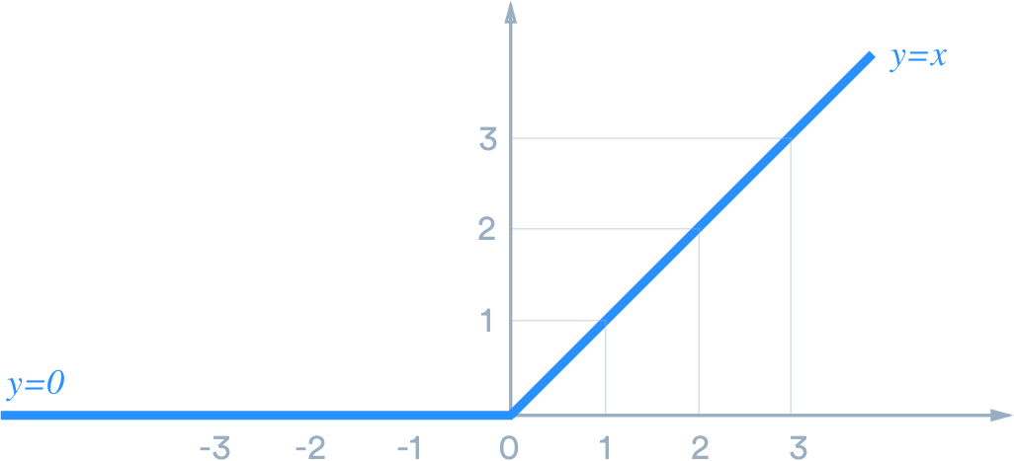
Rectified Linear Unit-ReLU
ReLU stands for rectified linear unit, and is a type of activation function. Mathematically, it is defined as
y = max(0, x)
ReLU is the most commonly used activation function in neural networks, especially in CNNs.
If you are unsure what activation function to use in your network, ReLU is usually a good first choice.

Slide 44
How does ReLU compare
ReLU is linear (identity) for all positive values, and zero for all negative values. This means that:
It’s cheap to compute as there is no complicated math. The model can therefore take less time to train or run.
It converges faster. Linearity means that the slope doesn’t plateau, or “saturate,” when x gets large.
It doesn’t have the vanishing gradient problem suffered by other activation functions like sigmoid or tanh.
It’s sparsely activated.
Since ReLU is zero for all negative inputs, it’s likely for any given unit to not activate at all.
This is often desirable (see below).

Slide 45
Sparsity
Why is sparsity good? It makes intuitive sense if we think about the biological neural network, which artificial ones try to imitate. While we have billions of neurons in our bodies, not all of them fire all the time for everything we do. Instead, they have different roles and are activated by different signals.
Sparsity results in concise models that often have better predictive power and less overfitting/noise. In a sparse network, it’s more likely that neurons are actually processing meaningful aspects of the problem. For example, in a model detecting cats in images, there may be a neuron that can identify ears, which obviously shouldn’t be activated if the image is about a building.
Finally, a sparse network is faster than a dense network, as there are fewer things to compute.

Slide 46
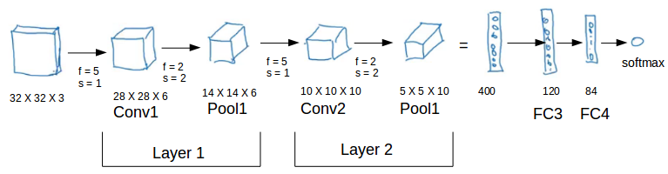
CNN Example
We’ll take things up a notch now. Let’s look at how a convolution neural network with convolutional and pooling layer works. Suppose we have an input of shape 32 X 32 X 3:

Slide 47
There are a combination of convolution and pooling layers at the beginning, a few fully connected layers at the end and finally a softmax classifier to classify the input into various categories. There are a lot of hyperparameters in this network which we have to specify as well.
Generally, we take the set of hyperparameters which have been used in proven research and they end up doing well. As seen in the above example, the height and width of the input shrinks as we go deeper into the network (from 32 X 32 to 5 X 5) and the number of channels increases (from 3 to 10).
All of these concepts and techniques bring up a very fundamental question – why convolutions? Why not something else?

Slide 48
Why Convolutions?
There are primarily two major advantages of using convolutional layers over using just fully connected layers:
Parameter sharing
Sparsity of connections
Consider the below example:

Slide 49
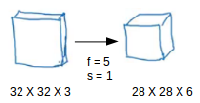
If we would have used just the fully connected layer, the number of parameters would be = 32*32*3*28*28*6, which is nearly equal to 14 million!
Makes no sense, right?
If we see the number of parameters in case of a convolutional layer, it will be = (5*5 + 1) * 6 (if there are 6 filters), which is equal to 156.
Convolutional layers reduce the number of parameters and speed up the training of the model significantly.

Slide 50
In convolutions, we share the parameters while convolving through the input. The intuition behind this is that a feature detector, which is helpful in one part of the image, is probably also useful in another part of the image.
So a single filter is convolved over the entire input and hence the parameters are shared.
The second advantage of convolution is the sparsity of connections.
For each layer, each output value depends on a small number of inputs, instead of taking into account all the inputs.

Slide 51
Classic Networks
In this section, we will look at the following popular networks:
LeNet-5
AlexNet
VGG
We will also see how ResNet works and finally go through a case study of an inception neural network.

Slide 52
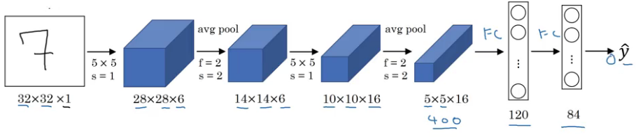
LeNet-5
It takes a grayscale image as input. Once we pass it through a combination of convolution and pooling layers, the output will be passed through fully connected layers and classified into corresponding classes. The total number of parameters in LeNet-5 are:
Parameters: 60 million
Layers flow: Conv -> Pool -> Conv -> Pool -> FC -> FC -> Output
Activation functions: Sigmoid/tanh and ReLu

Slide 53
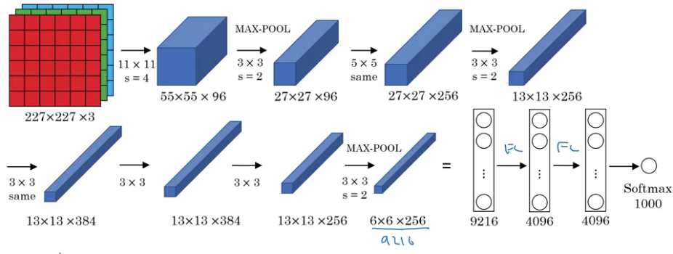
AlexNet
This network is similar to LeNet-5 with just more convolution and pooling layers:
Parameters: 60 million
Activation function: ReLu

Slide 54
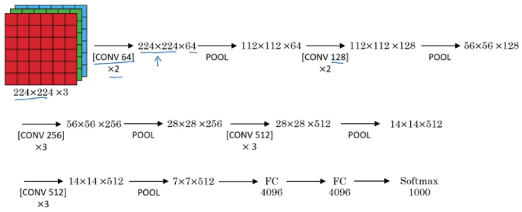
VGG-16
The underlying idea behind VGG-16 was to use a much simpler network where the focus is on having convolution layers that have 3 X 3 filters with a stride of 1 (and always using the same padding). The max pool layer is used after each convolution layer with a filter size of 2 and a stride of 2. Let’s look at the architecture of VGG-16:
As it is a bigger network, the number of parameters are also more.
Parameters: 138 million
These are three classic architectures. Next, we’ll look at more advanced architecture starting with ResNet.

Slide 55
ResNet
Training very deep networks can lead to problems like vanishing and exploding gradients.
How do we deal with these issues?
We can use skip connections where we take activations from one layer and feed it to another layer that is even more deeper in the network.
There are residual blocks in ResNet which help in training deeper networks.

Slide 56
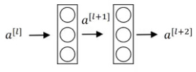
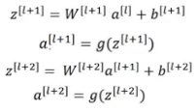
Residual Blocks
The general flow to calculate activations from different layers can be given as:

Slide 57


This is how we calculate the activations a^{[l+2]} using the activations a^{[l]} and then a^{[l+1]}. a^{[l]} needs to go through all these steps to generate a^{[l+2]}:
In a residual network, we make a change in this path. We take the activations a^{[l]} and pass them directly to the second layer:
So, the activations a^{[l+2]} will be:
a^{[l+2]} = g(z^{[l+2]} + a^{[l]})

Slide 58
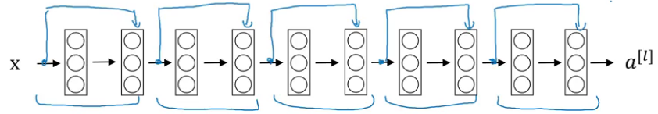
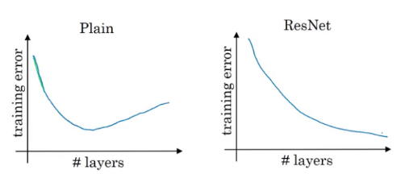
The residual network can be shown as:
The benefit of training a residual network is that even if we train deeper networks, the training error does not increase. Whereas in case of a plain network, the training error first decreases as we train a deeper network and then starts to rapidly increase:

Slide 59
Why ResNets Work?
In order to make a good model, we first have to make sure that it’s performance on the training data is good.
That’s the first test and there really is no point in moving forward if our model fails here.
We have seen earlier that training deeper networks using a plain network increases the training error after a point of time.
But while training a residual network, this isn’t the case.
Even when we build a deeper residual network, the training error generally does not increase.

Slide 60
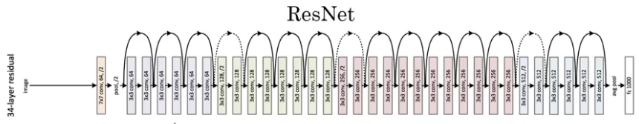
The equation to calculate activation using a residual block is given by:
a^{[l+2]} = g(z^{[l+2]} + a^{[l]})
a^{[l+2]} = g(w^{[l+2]} * a^{[l+1]} + b^{[l+2]} + a^{[l]})
Now, say w^{[l+2]} = 0 and the bias b^{[l+2]} is also 0, then:
a^{[l+2]} = g(a^{[l]})
It is fairly easy to calculate a^{[l+2]} knowing just the value of a^{[l]}. As per the research paper, ResNet is given by:

Slide 61
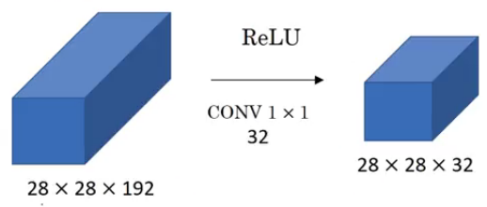
Networks in Networks and 1×1 Convolutions
Let’s see how a 1 X 1 convolution can be helpful. Suppose we have a 28 X 28 X 192 input and we apply a 1 X 1 convolution using 32 filters. So, the output will be 28 X 28 X 32:
The basic idea of using 1 X 1 convolution is to reduce the number of channels from the image. A couple of points to keep in mind:
We generally use a pooling layer to shrink the height and width of the image
To reduce the number of channels from an image, we convolve it using a 1 X 1 filter (hence reducing the computation cost as well)

Slide 62
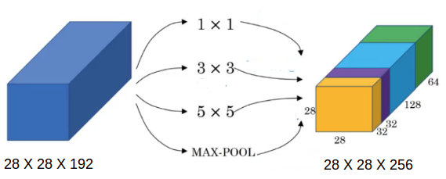
The Motivation Behind Inception Networks
While designing a convolutional neural network, we have to decide the filter size. Should it be a 1 X 1 filter, or a 3 X 3 filter, or a 5 X 5? Inception does all of that for us! Let’s see how it works.
Suppose we have a 28 X 28 X 192 input volume. Instead of choosing what filter size to use, or whether to use convolution layer or pooling layer, inception uses all of them and stacks all the outputs:

Slide 63
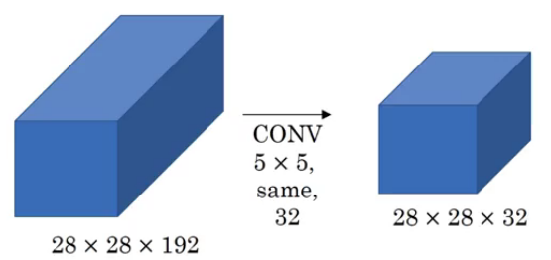
A good question to ask here – why are we using all these filters instead of using just a single filter size, say 5 X 5? Let’s look at how many computations would arise if we would have used only a 5 X 5 filter on our input:
Number of multiplies = 28 * 28 * 32 * 5 * 5 * 192 = 120 million! Can you imagine how expensive performing all of these will be?

Slide 64
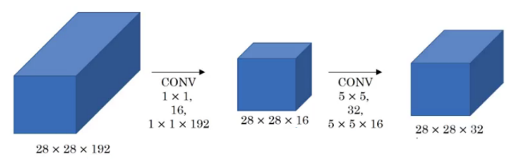
Now, let’s look at the computations a 1 X 1 convolution and then a 5 X 5 convolution will give us:
Number of multiplies for first convolution = 28 * 28 * 16 * 1 * 1 * 192 = 2.4 million
Number of multiplies for second convolution = 28 * 28 * 32 * 5 * 5 * 16 = 10 million
Total number of multiplies = 12.4 million
A significant reduction. This is the key idea behind inception.

Slide 65
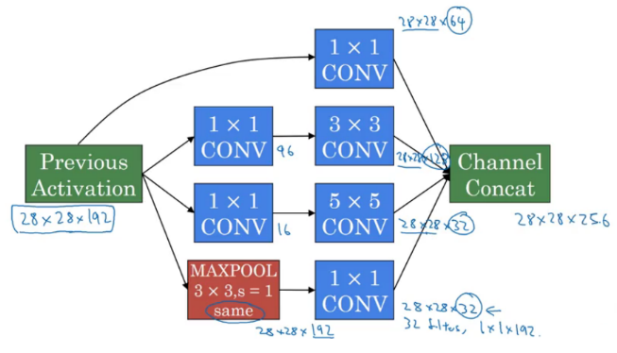
Inception Networks
We stack all the outputs together. Also, we apply a 1 X 1 convolution before applying 3 X 3 and 5 X 5 convolutions in order to reduce the computations. An inception model is the combination of these inception blocks repeated at different locations, some fully connected layer at the end, and a softmax classifier to output the classes.

Slide 66
Transfer Learning:
We can take a pretrained network and transfer that to a new task which we are working on.
In transfer learning, we take the complete network, remove a few layers from it, and add custom layers on top of the remaining layers to train our model.
In essense, we are extracting features from a pretrained model and using those to classify and train our model

Slide 67
Data Augmentation:
Deep learning models perform well when we have a large amount of data. There are quite a few domains where getting enough data is a problem.
In such cases, we use data augmentation to generate training data from the available data.
Some of the common augmentation methods are:
Mirroring: Here we take the mirror image. The class of the image will not change in this case
Random Cropping
Rotating
Shearing
Color Shifting: We change the RGB scale of the image randomly.

Slide 68
The Mathematics Behind Convolutional Neural Networks (CNNs)
Convolutional neural networks (CNNs) are all the rage in the deep learning and computer vision community
How does this CNN architecture work?
We’ll explore the math behind the building blocks of a convolutional neural network

Slide 69
Introduction to Neural Networks
Neural Networks are at the core of all deep learning algorithms.
But before you deep dive into these algorithms, it’s important to have a good understanding of the concept of neural networks.
These neural networks try to mimic the human brain and its learning process.
Like a brain takes the input, processes it and generates some output, so does the neural network.
These three actions – receiving input, processing information, generating output – are represented in the form of layers in a neural network – input, hidden and output.
These individual units in the layers are called neurons. The complete training process of a neural network involves two steps.

Slide 70
Forward Propagation
Images are fed into the input layer in the form of numbers.
These numerical values denote the intensity of pixels in the image.
The neurons in the hidden layers apply a few mathematical operations on these values (which we will discuss later).
In order to perform these mathematical operations, there are certain parameter values that are randomly initialized.
Post these mathematical operations at the hidden layer, the result is sent to the output layer which generates the final prediction.

Slide 71
Backward Propagation
Once the output is generated, the next step is to compare the output with the actual value.
Based on the final output, and how close or far this is from the actual value (error), the values of the parameters are updated.
The forward propagation process is repeated using the updated parameter values and new outputs are generated.
This is the base of any neural network algorithm. In this article, we will look at the forward and backward propagation steps for a convolutional neural network!

Slide 72
Convolutional Neural Network (CNN) Architecture
Consider this – you are asked to identify objects in two given images.
How would you go about doing that?
Typically, you would observe the image, try to identify different features, shapes and edges from the image.
Based on the information you gather, you would say that the object is a dog or a car and so on.
This is precisely what the hidden layers in a CNN do – find features in the image.
The convolutional neural network can be broken down into two parts:
The convolution layers: Extracts features from the input
The fully connected (dense) layers: Uses data from convolution layer to generate output

Slide 73
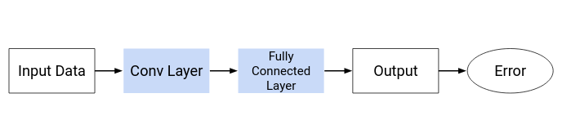
As we discussed in the previous section, there are two important processes involved in the training of any neural network:
Forward Propagation: Receive input data, process the information, and generate output
Backward Propagation: Calculate error and update the parameters of the network
We will cover both of these one by one. Let us start with the forward propagation process.

Slide 74
Convolutional Neural Network (CNN): Forward Propagation
Convolution Layer
You know how we look at images and identify the object’s shape and edges?
A convolutional neural network does this by comparing the pixel values.
Below is an image of the number 8 and the pixel values for this image.
Take a look at the image closely.
You would notice that there is a significant difference between the pixel values around the edges of the number.
Hence, a simple way to identify the edges is to compare the neighboring pixel value.

Slide 75
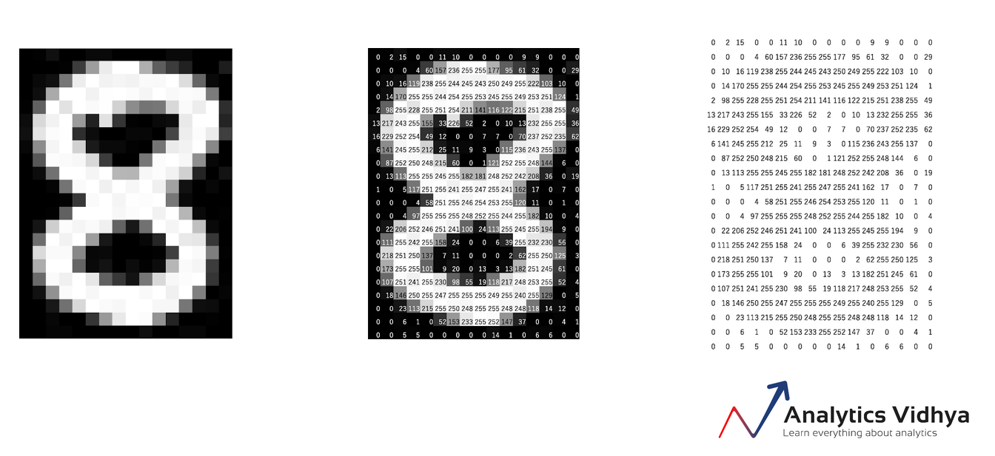
Do we need to traverse pixel by pixel and compare these values? No! To capture this information, the image is convolved with a filter (also known as a ‘kernel’).
Convolution is often represented mathematically with an asterisk * sign. If we have an input image represented as X and a filter represented with f, then the expression would be:
Z = X * f

Slide 76
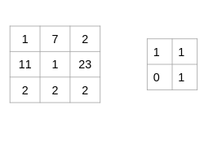
Let us understand the process of convolution using a simple example. Consider that we have an image of size 3 x 3 and a filter of size 2 x 2:
The filter goes through the patches of images, performs an element-wise multiplication, and the values are summed up:
(1x1 + 7x1 + 11x0 + 1x1) = 9
(7x1 + 2x1 + 1x0 + 23x1) = 32
(11x1 + 1x1 + 2x0 + 2x1) = 14
(1x1 + 23x1 + 2x0 + 2x1) = 26

Slide 77
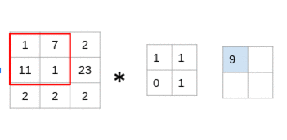
Look at that closely – you’ll notice that the filter is considering a small portion of the image at a time.
We can also imagine this as a single image broken down into smaller patches, each of which is convolved with the filter.
Z = X * f

Slide 78
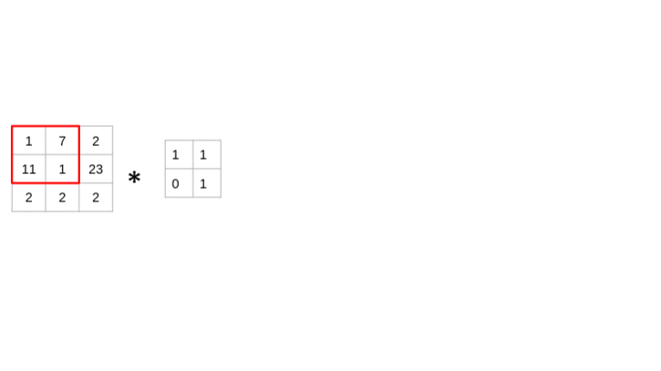
Look at that closely – you’ll notice that the filter is considering a small portion of the image at a time.
We can also imagine this as a single image broken down into smaller patches, each of which is convolved with the filter.

Slide 79
Fully Connected Layer
So far, the convolution layer has extracted some valuable features from the data.
These features are sent to the fully connected layer that generates the final results.
The fully connected layer in a CNN is nothing but the traditional neural network!
The output from the convolution layer was a 2D matrix.
Ideally, we would want each row to represent a single input image.
In fact, the fully connected layer can only work with 1D data.
Hence, the values generated from the previous operation are first converted into a 1D format.

Slide 80
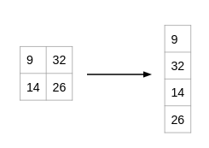
Once the data is converted into a 1D array, it is sent to the fully connected layer.
All of these individual values are treated as separate features that represent the image.
The fully connected layer performs two operations on the incoming data – a linear transformation and a non-linear transformation.

Slide 81
Once the data is converted into a 1D array, it is sent to the fully connected layer.
All of these individual values are treated as separate features that represent the image.
The fully connected layer performs two operations on the incoming data – a linear transformation and a non-linear transformation.
We first perform a linear transformation on this data. The equation for linear transformation is:
Z = W^{T}.X + b

Slide 82
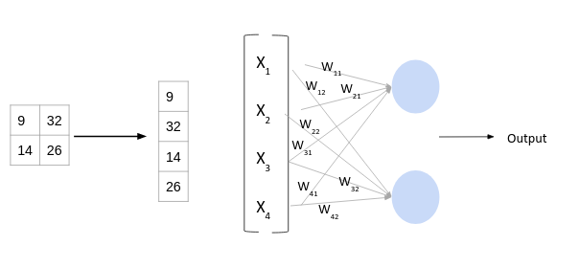
Here, X is the input, W is weight, and b (called bias) is a constant.
Note that the W in this case will be a matrix of (randomly initialized) numbers.
Can you guess what would be the size of this matrix?

Slide 83
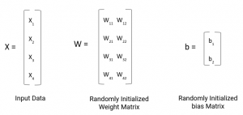
Considering the size of the matrix is (m, n) – m will be equal to the number of features or inputs for this layer.
Since we have 4 features from the convolution layer, m here would be 4.
The value of n will depend on the number of neurons in the layer.
For instance, if we have two neurons, then the shape of weight matrix will be (4, 2):

Slide 84
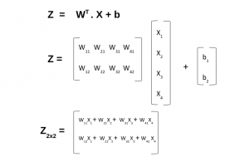
Having defined the weight and bias matrix, let us put these in the equation for linear transformation:
Now, there is one final step in the forward propagation process – the non-linear transformations. Let us understand the concept of non-linear transformation and it’s role in the forward propagation process.

Slide 85
Non-Linear transformation
The linear transformation alone cannot capture complex relationships.
Thus, we introduce an additional component in the network which adds non-linearity to the data.
This new component in the architecture is called the activation function.
There are a number of activation functions that you can use – here is the complete list:
https://www.analyticsvidhya.com/blog/2020/01/fundamentals-deep-learning-activation-functions-when-to-use-them/?utm_source=blog&utm_medium=mathematics-convolutional-neural-network

Slide 86
These activation functions are added at each layer in the neural network.
The activation function to be used will depend on the type of problem you are solving.
We will be working on a binary classification problem and will use the Sigmoid activation function.
Let’s quickly look at the mathematical expression for this:
f(x) = 1/(1+e^{-x})
The range of a Sigmoid function is between 0 and 1.
This means that for any input value, the result would always be in the range (0, 1).
A Sigmoid function is majorly used for binary classification problems and we will use this for both convolution and fully-connected layers.

Slide 87
Forward Propagation Summary
Step 1: Load the input images in a variable (say X)
Step 2: Define (randomly initialize) a filter matrix. Images are convolved with the filter
Z₁ = X * f
Step 3: Apply the Sigmoid activation function on the result
A = sigmoid(Z₁)
Step 4: Define (randomly initialize) weight and bias matrix. Apply linear transformation on the values
Z₂ = W^{T}.A + b
Step 5: Apply the Sigmoid function on the data. This will be the final output
O = sigmoid(Z₂)

Slide 88
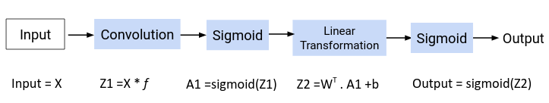
Now the question is – how are the values in the filter decided?
The CNN model treats these values as parameters, which are randomly initialized and learned during the training process.
We will answer this in the next section.

Slide 89
Convolutional Neural Network (CNN): Backward Propagation
During the forward propagation process, we randomly initialized the weights, biases and filters.
These values are treated as parameters from the convolutional neural network algorithm.
In the backward propagation process, the model tries to update the parameters such that the overall predictions are more accurate.
For updating these parameters, we use the gradient descent technique.
Let us understand the concept of gradient descent with a simple example.

Slide 90
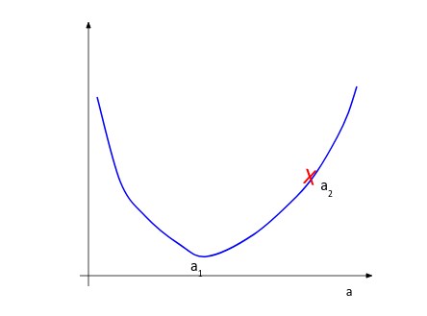
Consider that following in the curve for our loss function where we have a parameter a:
During the random initialization of the parameter, we get the value of a as a₂.
It is clear from the picture that the minimum value of loss is at a₁ and not a₂.
The gradient descent technique tries to find this value of parameter (a) at which the loss is minimum.

Slide 91
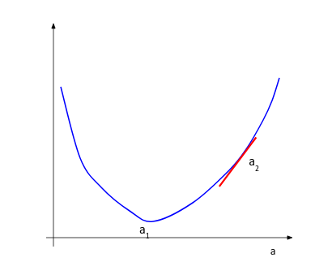
We understand that we need to update the value a₂ and bring it closer to a_{1.}
To decide the direction of movement, i.e. whether to increase or decrease the value of the parameter, we calculate the gradient or slope at the current point.

Slide 92
Based on the value of the gradient, we can determine the updated parameter values.
When the slope is negative, the value of the parameter will be increased, and when the slope is positive, the value of the parameter should be decreased by a small amount.
Here is a generic equation for updating the parameter values:
new_parameter = old_parameter - (learning_rate x gradient_of_parameter)
The learning rate is a constant that controls the amount of change being made to the old value.
The slope or the gradient determine the direction of the new values, that is, should the values be increased or decreased.
So, we need to find the gradients, that is, change in error with respect to the parameters in order to update the parameter values.
https://www.analyticsvidhya.com/blog/2017/03/introduction-to-gradient-descent-algorithm-along-its-variants/?utm_source=blog&utm_medium=mathematics-convolutional-neural-network

Slide 93
Backward Propagation: Fully Connected Layer
As discussed previously, the fully connected layer has two parameters – weight matrix and bias matrix.
Let us start by calculating the change in error with respect to weights – ∂E/∂W.
Since the error is not directly dependent on the weight matrix, we will use the concept of chain rule to find this value.
The computation graph shown below will help us define ∂E/∂W:

Slide 94
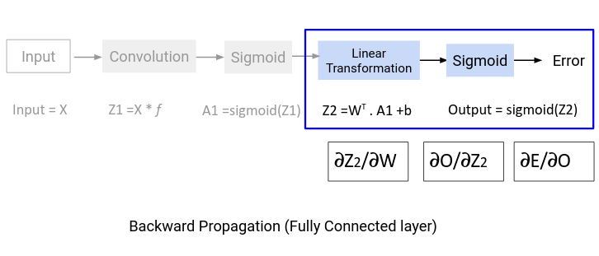
∂E/∂W = ∂E/∂O . ∂O/∂Z2. ∂z/∂W
We will find the values of these derivatives separately.

Slide 95
1. Change in error with respect to output
Suppose the actual values for the data are denoted as y’ and the predicted output is represented as O.
Then the error would be given by this equation:
E = (y' - O)²/2
If we differentiate the error with respect to the output, we will get the following equation:
∂E/∂O = -(y'-O)

Slide 96
2. Change in output with respect to Z₂ (linear transformation output)
To find the derivative of output O with respect to Z₂, we must first define O in terms of Z₂.
If you look at the computation graph from the forward propagation section above, you would see that the output is simply the sigmoid of Z₂.
Thus, ∂O/∂Z₂ is effectively the derivative of Sigmoid.
Recall the equation for the Sigmoid function:
f(x) = 1/(1+e^{-x})
The derivative of this function comes out to be:
f'(x) = (1+e^{-x})⁻¹[1-(1+e^{-x})⁻¹]
f'(x) = sigmoid(x)(1-sigmoid(x))
∂O/∂Z2 = (O)(1-O)

Slide 97
3. Change in Z₂ with respect to W (Weights)
The value Z₂ is the result of the linear transformation process. Here is the equation of Z₂ in terms of weights:
Z₂ = W^{T}.A₁ + b
On differentiating Z₂ with respect to W, we will get the value A₁ itself:
∂Z₂/∂W = A₁
Now that we have the individual derivations, we can use the chain rule to find the change in error with respect to weights:
∂E/∂W = ∂E/∂O . ∂O/∂Z₂. ∂Z₂/∂W
∂E/∂W = -(y'-o) . sigmoid'. A₁
The shape of ∂E/∂W will be the same as the weight matrix W. We can update the values in the weight matrix using the following equation:
W_new = W_old - lr*∂E/∂W
Updating the bias matrix follows the same procedure.

Slide 98
Backward Propagation: Convolution Layer
For the convolution layer, we had the filter matrix as our parameter.
During the forward propagation process, we randomly initialized the filter matrix.
We will now update these values using the following equation:
new_parameter = old_parameter - (learning_rate * gradient_of_parameter)
To update the filter matrix, we need to find the gradient of the parameter – dE/df.
Here is the computation graph for backward propagation:

Slide 99
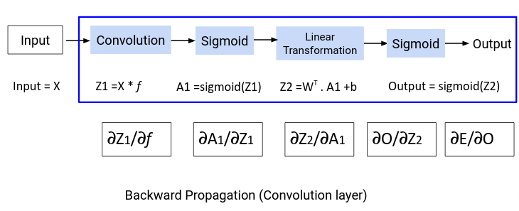
From the above graph we can define the derivative ∂E/∂f as:
∂E/∂f = ∂E/∂O.∂O/∂Z₂.∂Z₂/∂A₁ .∂A₁/∂Z₁.∂Z₁/∂f
We have already determined the values for ∂E/∂O and ∂O/∂Z2. Let us find the values for the remaining derivatives.

Slide 100
1. Change in Z₂ with respect to A₁
To find the value for ∂Z₂/∂A₁ , we need to have the equation for Z₂ in terms of A₁:
Z₂ = W^{T}.A₁ + b
On differentiating the above equation with respect to A₁, we get W^{T} as the result:
∂Z₂/∂A₁ = W^{T}

Slide 101
2. Change in A₁ with respect to Z₁
The next value that we need to determine is ∂A₁/∂Z₁. Have a look at the equation of A₁
A₁ = sigmoid(Z₁)
This is simply the Sigmoid function. The derivative of Sigmoid would be:
∂A₁/∂Z₁ = (A₁)(1-A₁)

Slide 102
3. Change in Z₁ with respect to filter f
Finally, we need the value for ∂Z₁/∂f. Here’s the equation for Z₁
Z₁ = X * f
Differentiating Z with respect to f will simply give us X:
∂Z₁/∂f = X
Now that we have all the required values, let’s find the overall change in error with respect to the filter:
∂E/∂f = ∂E/∂O.∂O/∂Z₂.∂Z₂/∂A₁ .∂A₁/∂Z₁ * ∂Z₁/∂f

Slide 103
Notice that in the equation above, the value (∂E/∂O.∂O/∂Z₂.∂Z₂/∂A₁ .∂A₁/∂Z) is convolved with ∂Z₁/∂f instead of using a simple dot product.
Why? The main reason is that during forward propagation, we perform a convolution operation for the images and filters.
This is repeated in the backward propagation process.
Once we have the value for ∂E/∂f, we will use this value to update the original filter value:
f = f - lr*(∂E/∂f)
This completes the backpropagation section for convolutional neural networks.

Slide 104
Feed forward and Back propagation

